Slide 1

INTRODUCTION TO
ANDROID

Slide 2
Contents
Introduction
Installation
Setup first project
Setup embedded emulator
Build a simple application
Run an application

Slide 3

Introduction

Slide 4
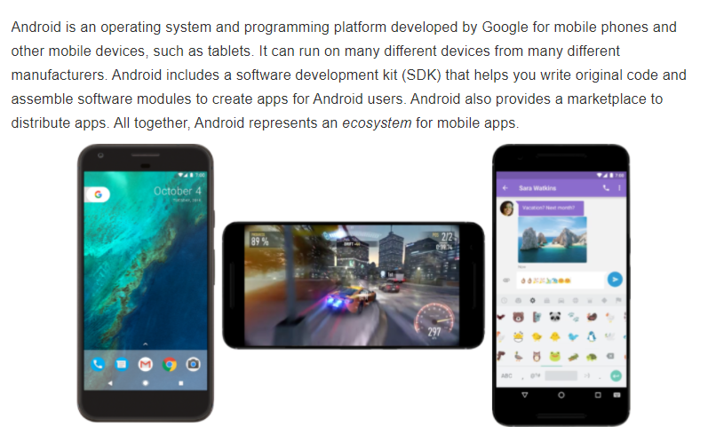
What is Android?

Slide 5
Installation

Slide 6
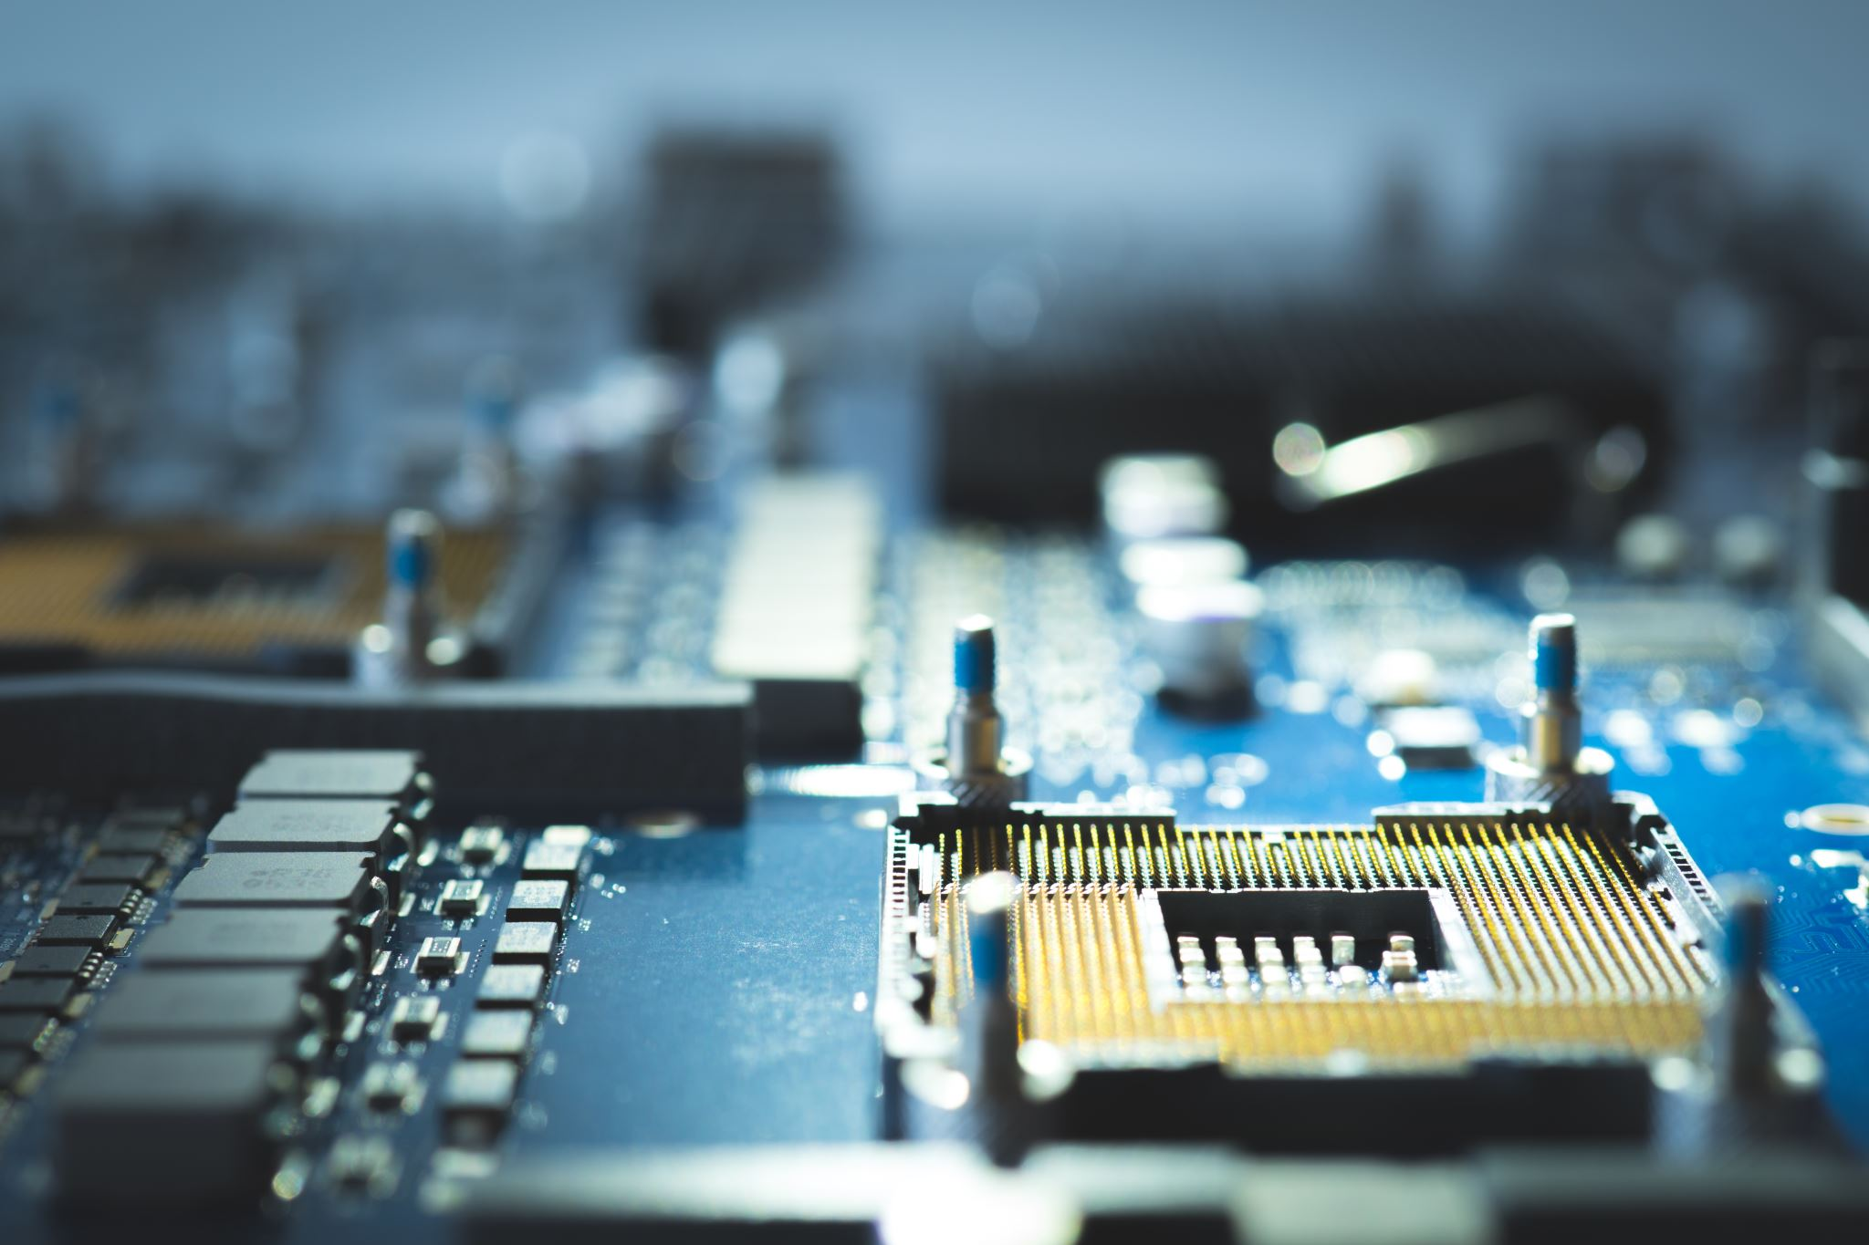
Windows – Install Android Studio

Slide 7
To download Android and SDK
Open https://www.openhandsetalliance.com/
Introduce the emulator.
Demo on how to use emulator

Slide 8
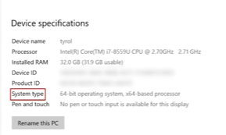
Download and install
Link to download : https://android-developers.googleblog.com/2019/06/moving-android-studio-and-android.html
Check your device specification:

Slide 9
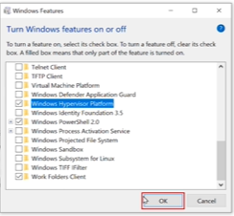
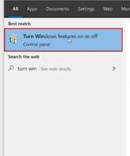
Processor: if Intel : good to go!
AMD => Start >

Slide 10
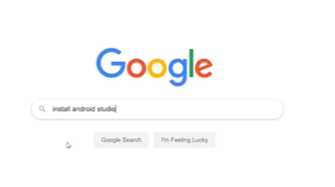
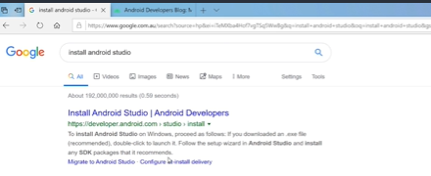

Slide 11
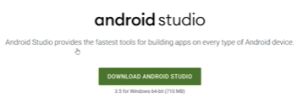

Slide 12
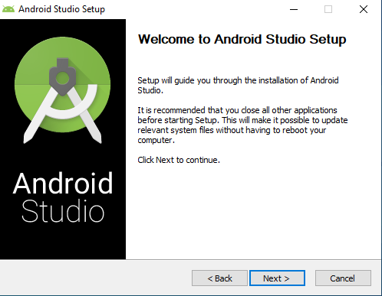

Slide 13
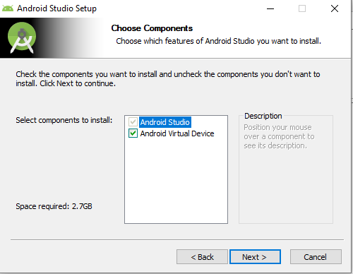
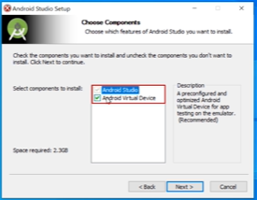

Slide 14
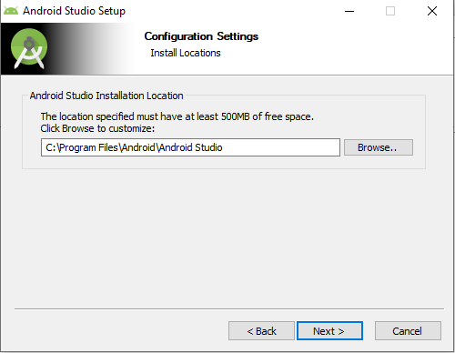

Slide 15
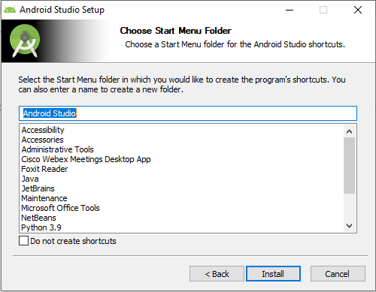

Slide 16
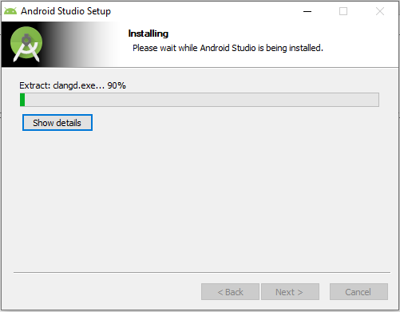

Slide 17
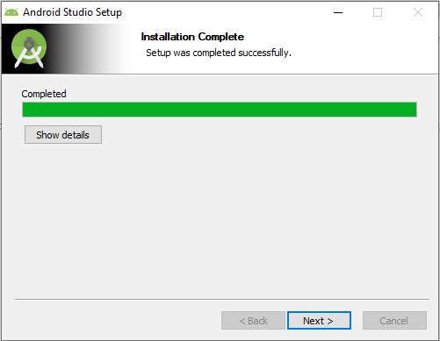
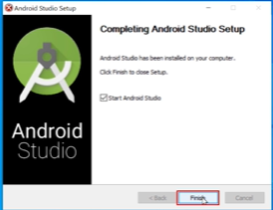

Slide 18
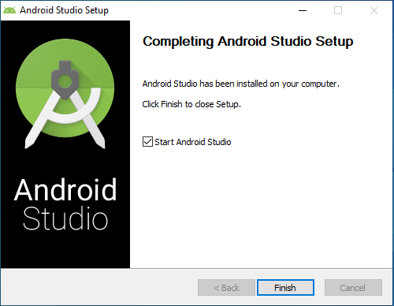


Slide 19
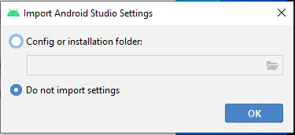

Slide 20
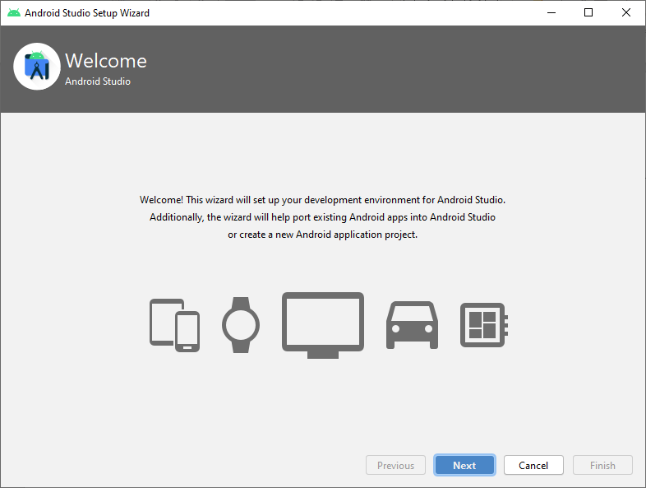

Slide 21
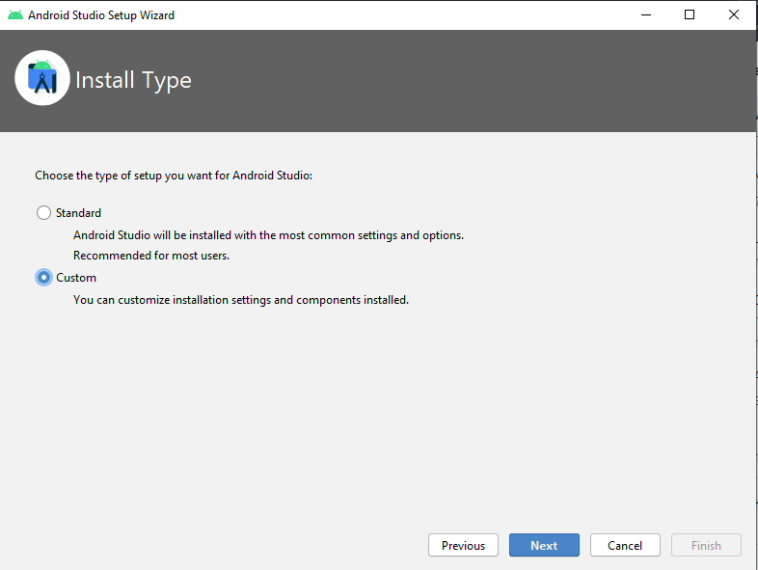

Slide 22
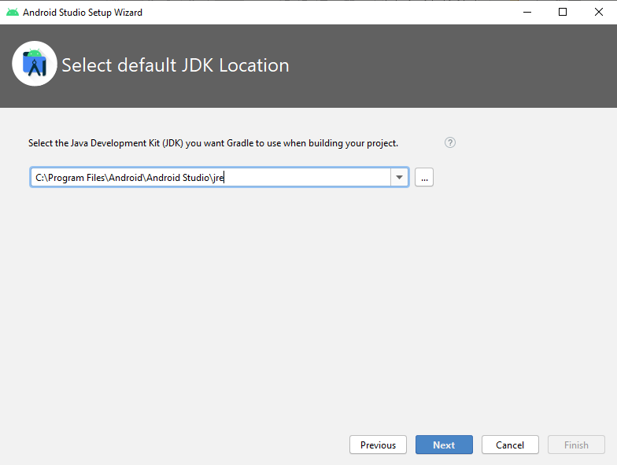

Slide 23
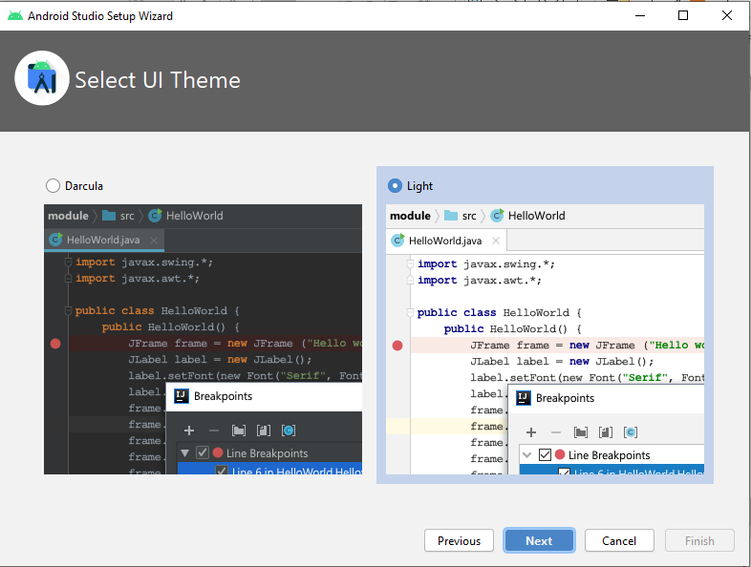

Slide 24
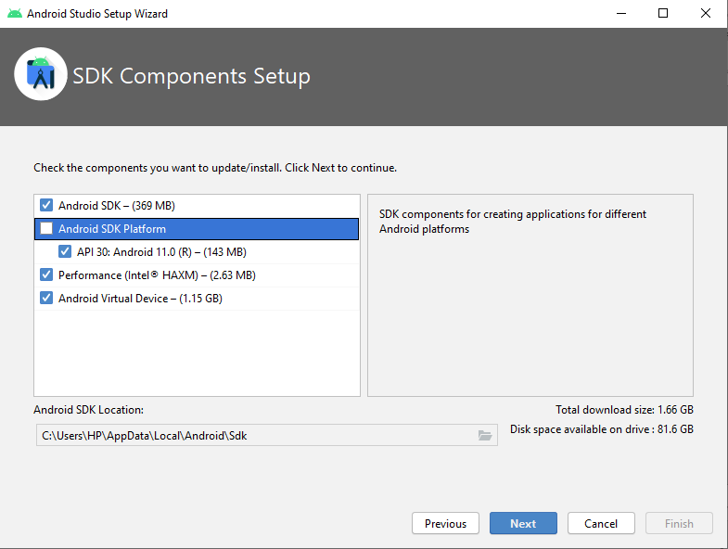
If you are using AMD,
deselect that option in a box.

Slide 25
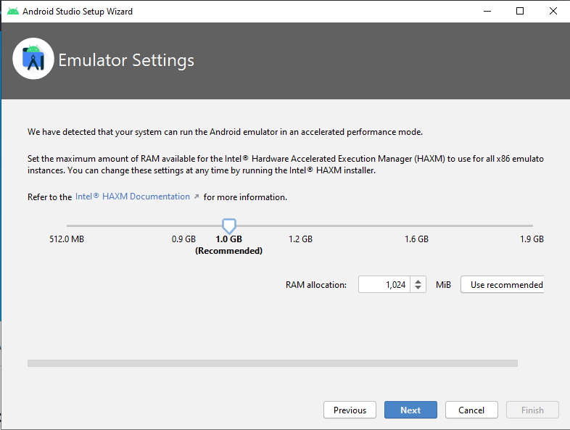

Slide 26
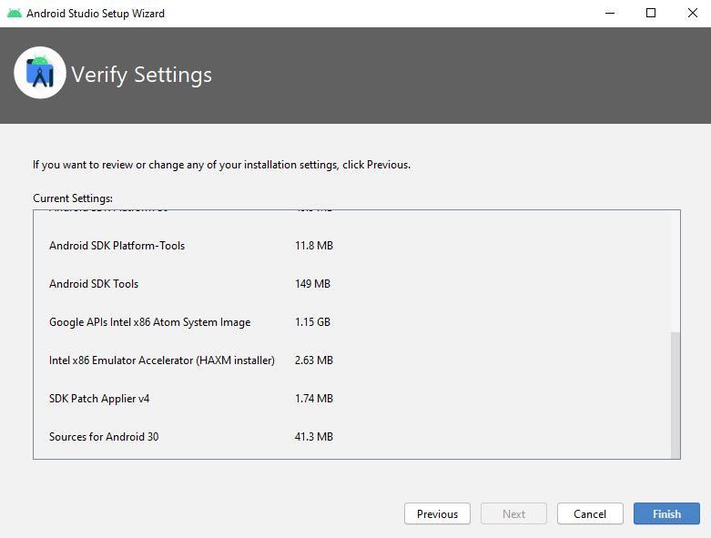

Slide 27
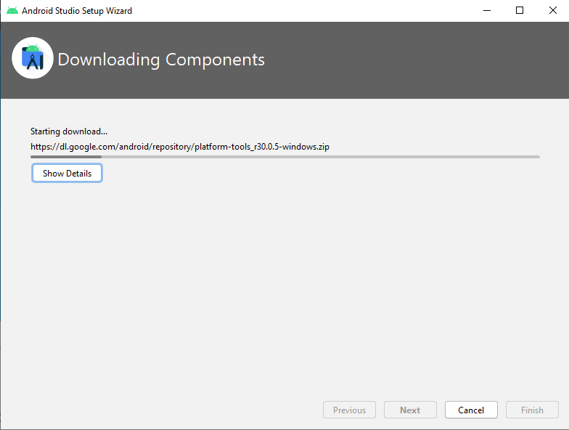

Slide 28
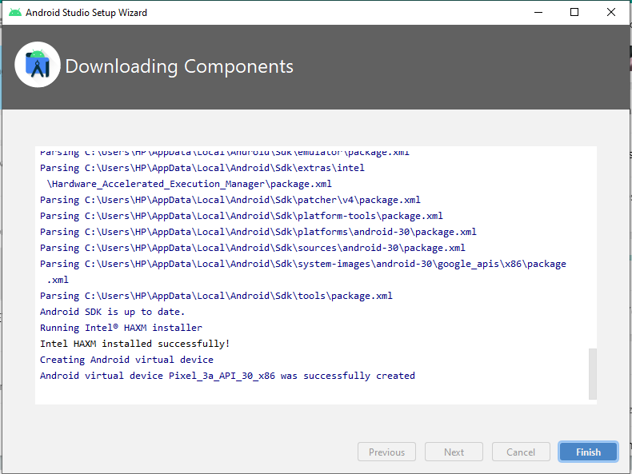

Slide 29
Configure Android SDK

Slide 30
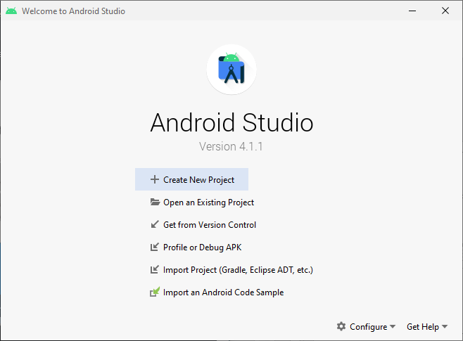

Slide 31
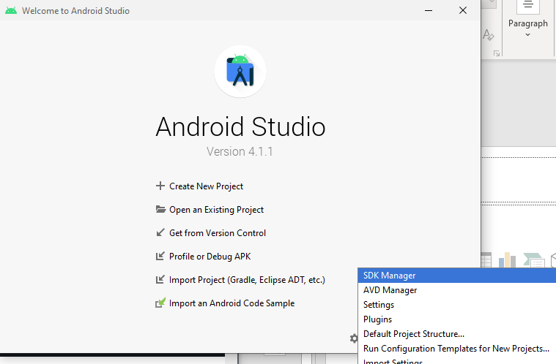

Slide 32
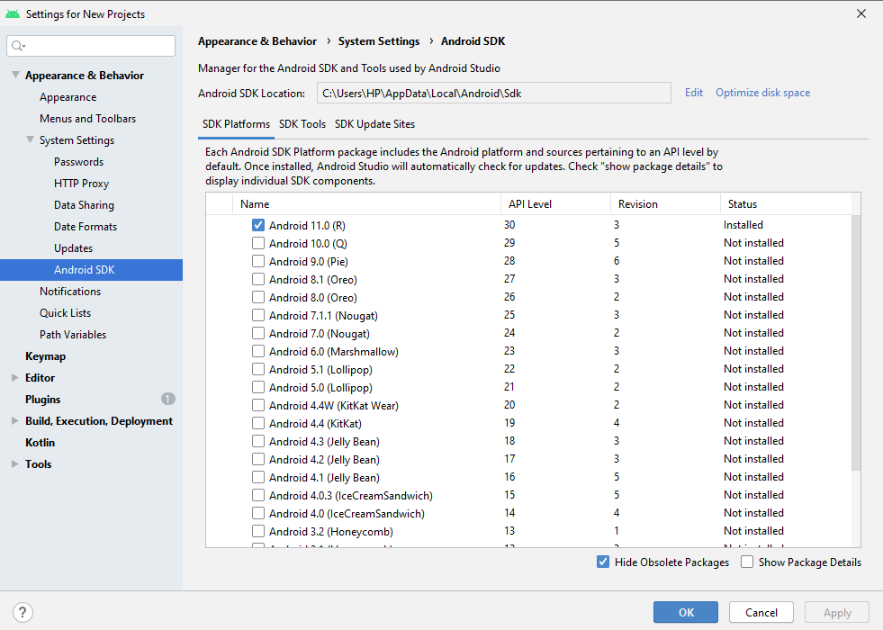

Slide 33
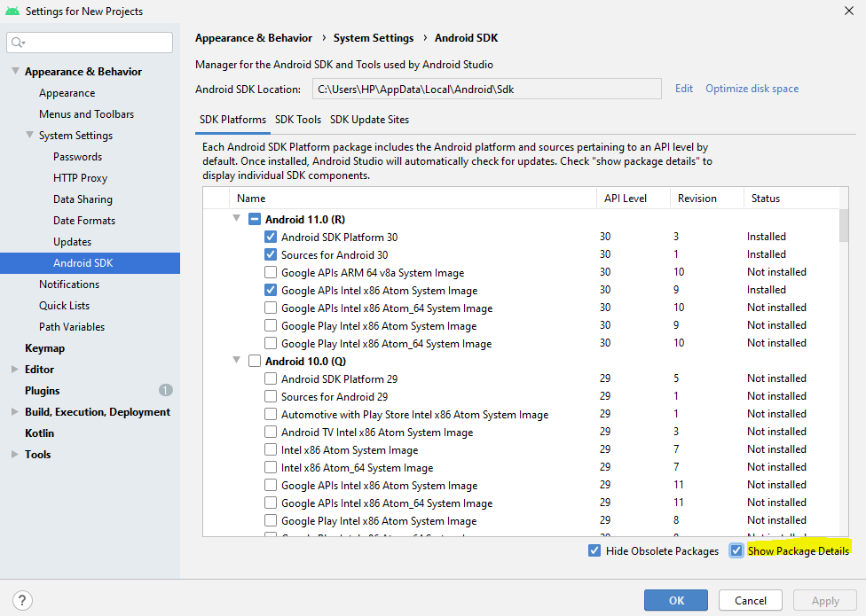

Slide 34
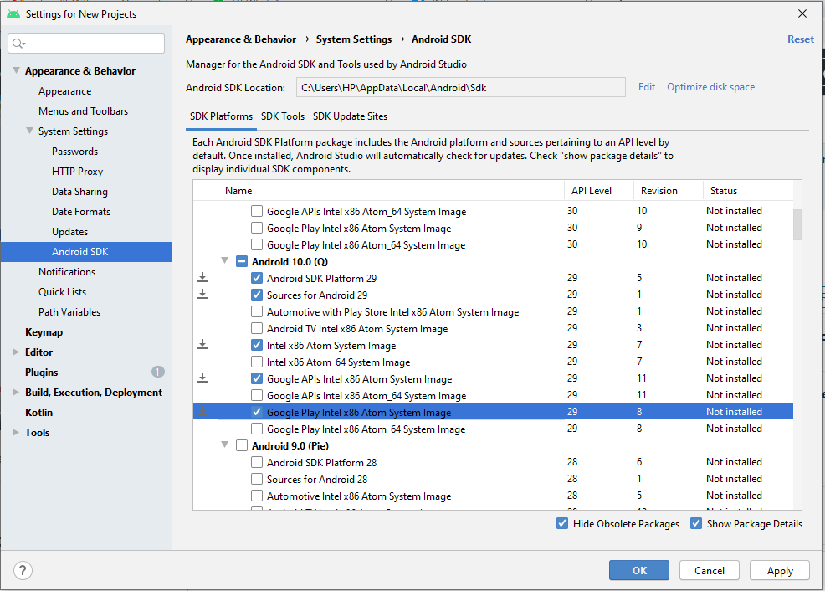

Slide 35
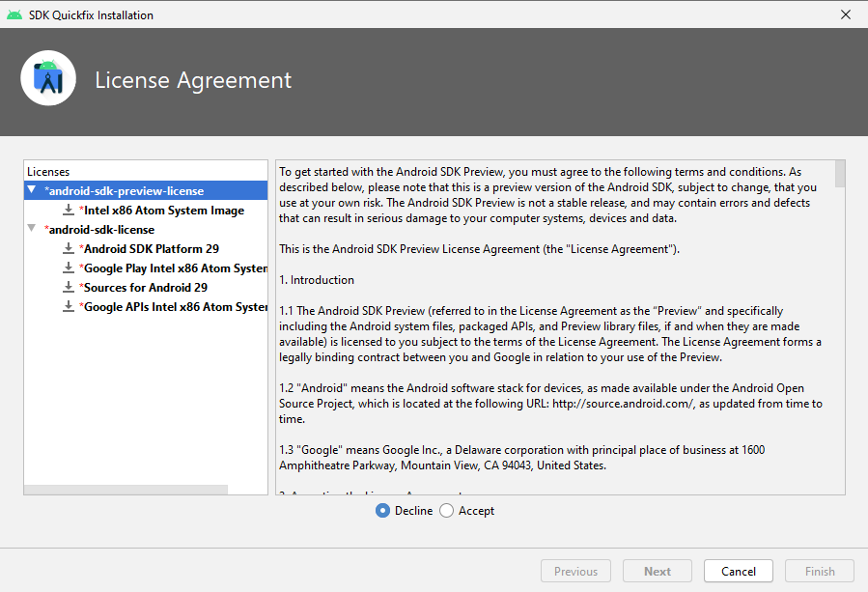

Slide 36
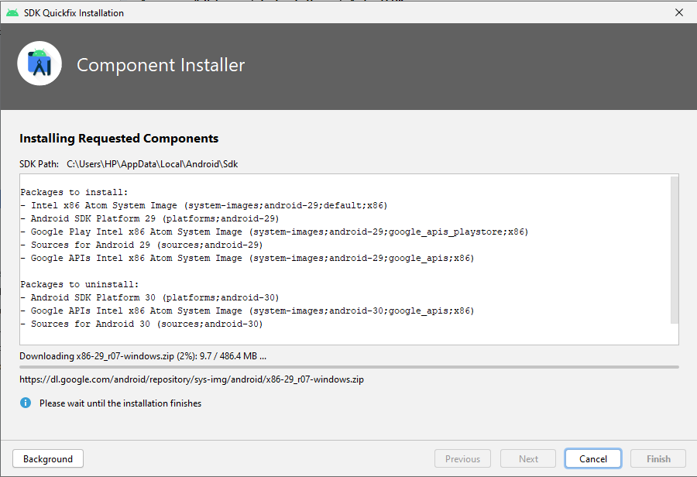

Slide 37
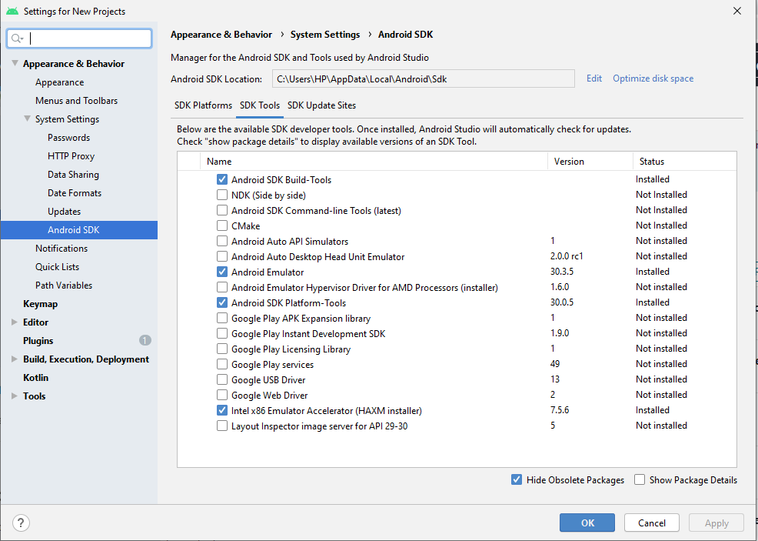

Slide 38
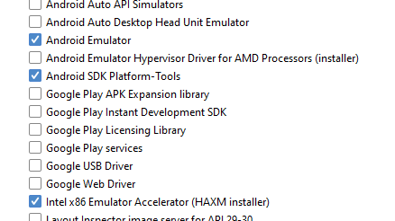
Details and make sure its checked

Slide 39

Apply then ok

Slide 40
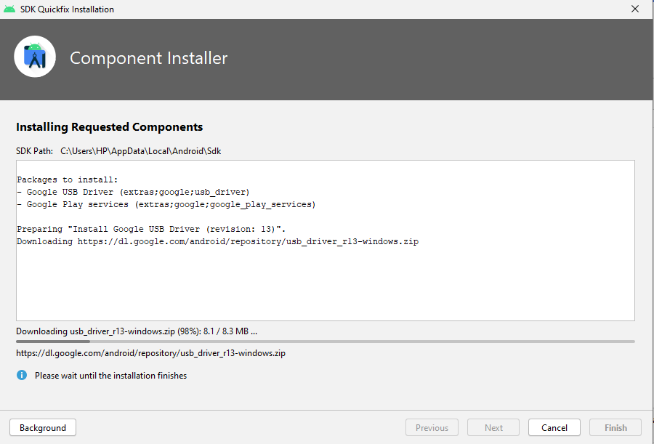

Slide 41
Android Studio Settings

Slide 42
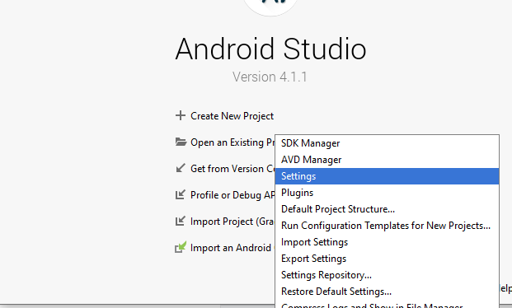

Slide 43
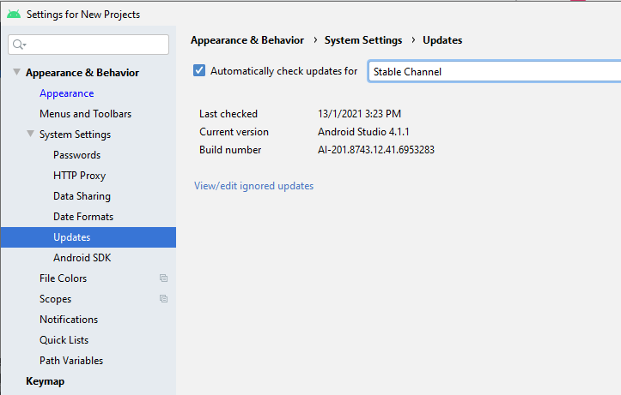
Choose stable

Slide 44
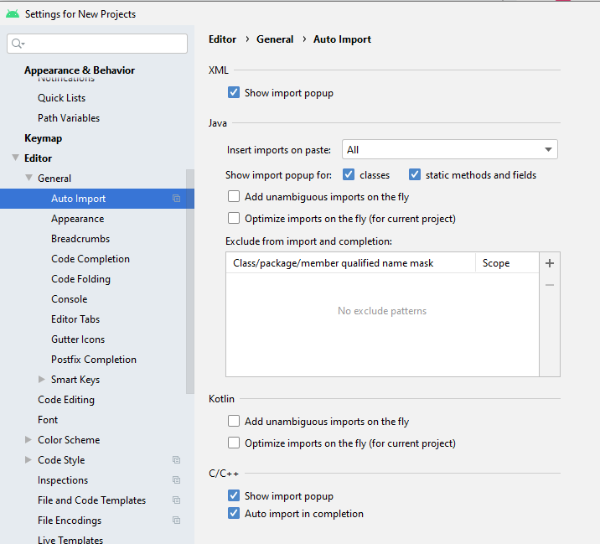

Slide 45
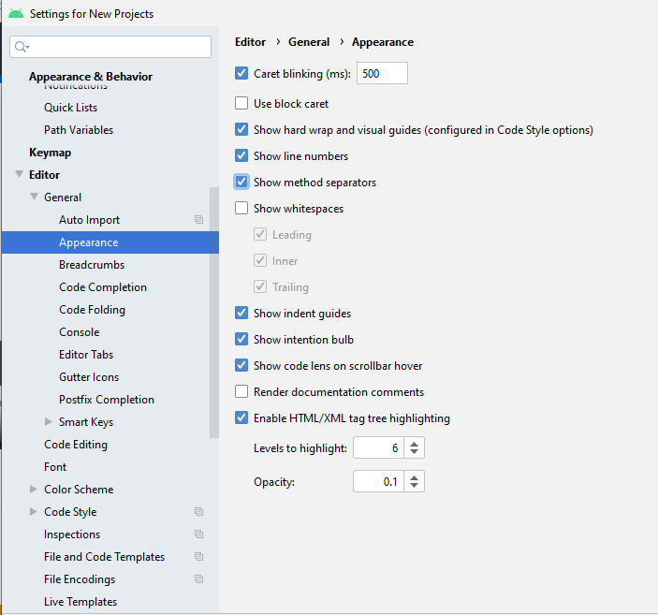

Slide 46
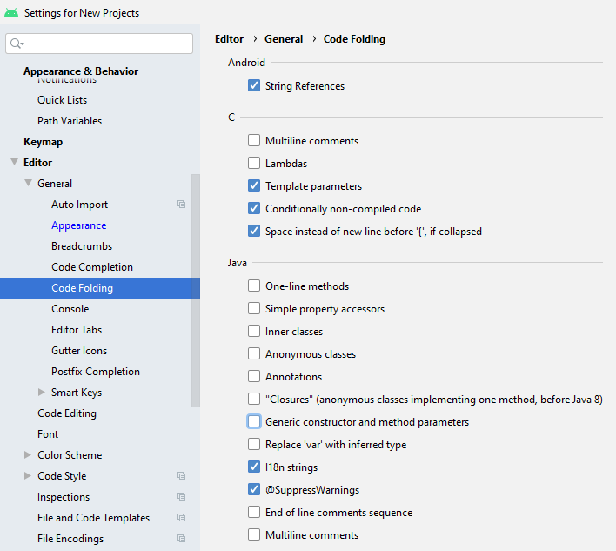

Slide 47
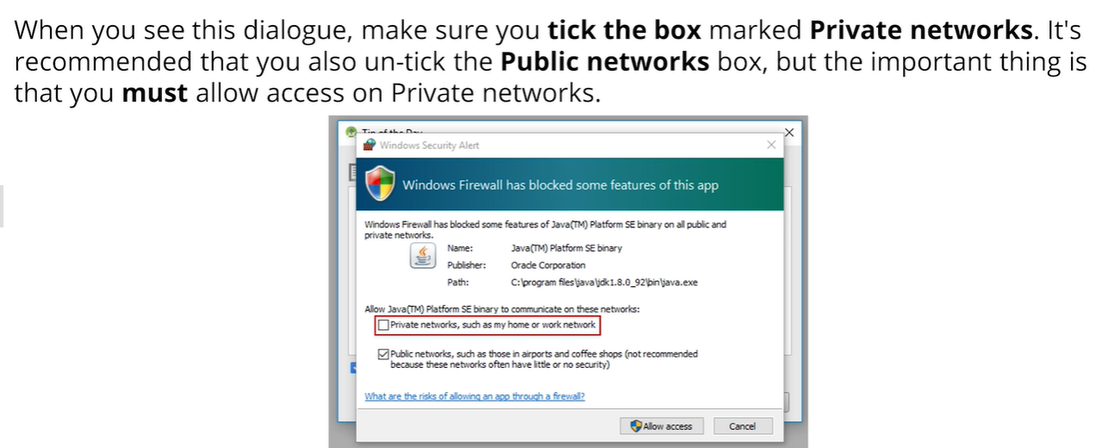
For Windows User

Slide 48

Enable VT-X in BIOS

Slide 49
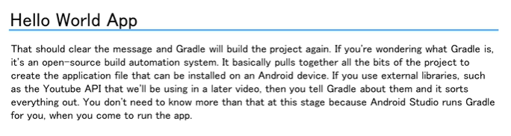
To speed up the emulator

Slide 50
Setup First Project

Slide 51
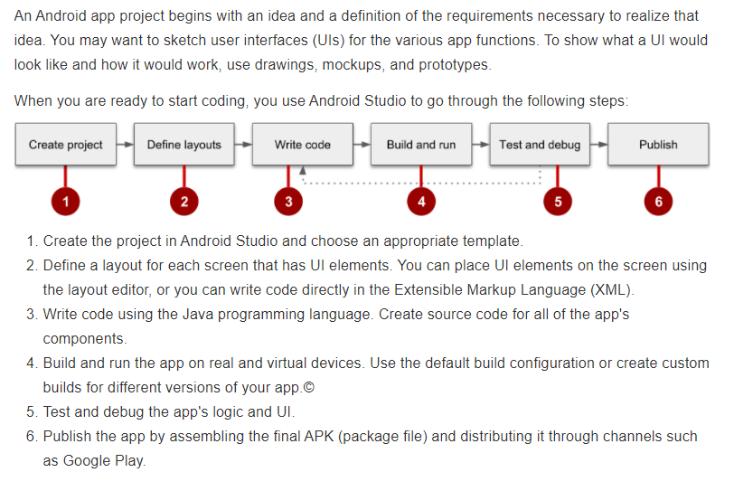
The development process

Slide 52
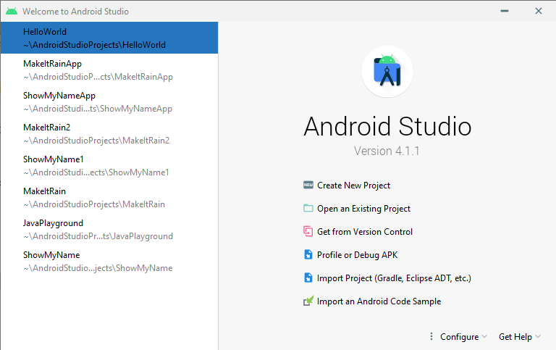
STEP 1:
Create New Project

Slide 53
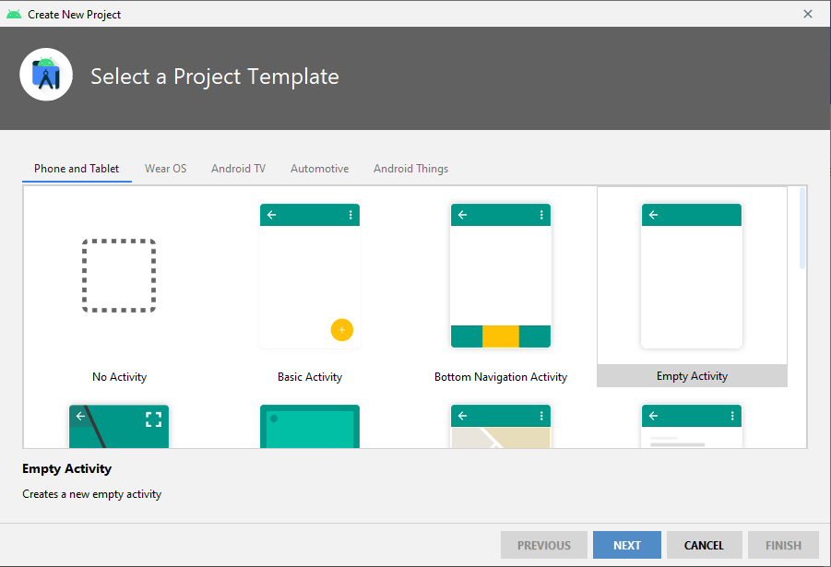
STEP 2
Select a
Project
template

Slide 54
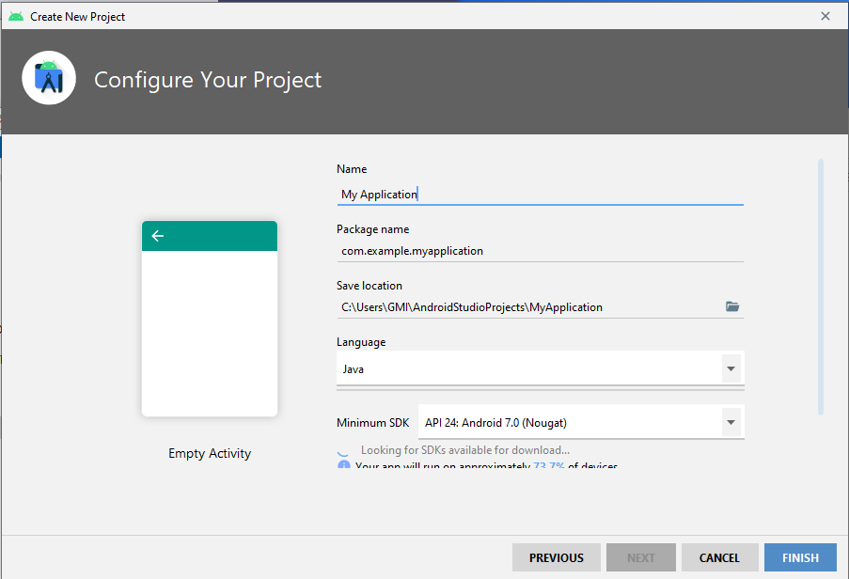
STEP 3
Configure
Your project

Slide 55
Package Name
com.example.myapplication
Com = commercial application (just like .com, most people register their app as a com app)
First level = always the publishing entity's' name
Second level (optional) = sub-devison, group, or project name
Final level = product name

Slide 56
Setup Embedded Emulator

Slide 57
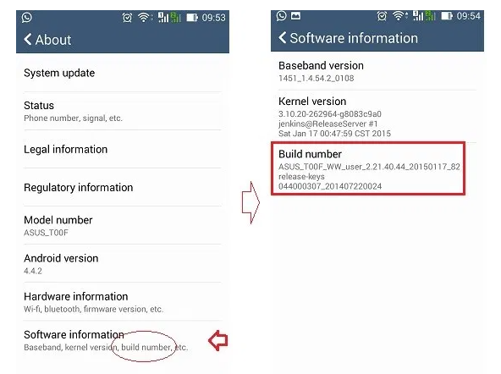
Step by step USB Debugging
Setting > About > Search for Build Number > Click for 7 times

Slide 58
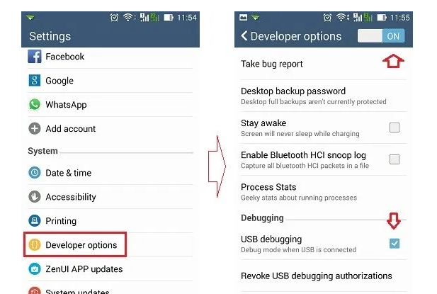
Step by step USB Debugging

Slide 59
Build a simple application

Slide 60


App: Hello World

Slide 61


App: Show My Name

Slide 62

Make it Rain

Slide 63

Make It Rain

Slide 64
CHALLENGE
Continue to do this project.
If you reached $20,000.0
The font color will change to RED and message will pop up.
“You are a rich man!”

Slide 65
Run an application

Slide 66

THE END

