Slide 1

ANDROID LAYOUTS, CONSTRAINT AND DATA BINDING

Slide 2
Contents
Introduction
Layouts in Android
Build an App: User Interface Setup
Build an App: Adding ScrollView
Build and App: Adding Button and EditText
Android Data Binding

Slide 3

Introduction

Slide 4
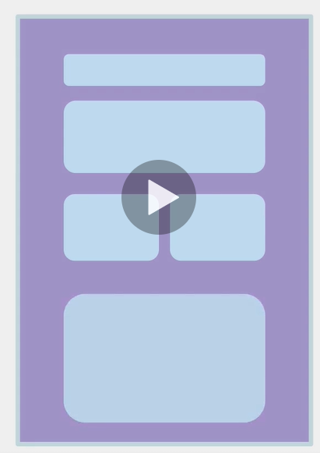
ANDROID LAYOUTS
Layouts in Android are very important because they enable layout views or widgets on the screen
Anything that is on screen is a View.
It inherits from the View Class.

Slide 5
Layout and Resources for UI

Slide 6
LinearLayout
ViewGroup
FrameLayout
ScrollView
ConstraintLayout
Button
View
TextView
EditText
ImageView
Notes:
The View class is the main parent class for anything that we out on the screen in Android.
For Example, the View class has its immediate children, the View Group class and the image view and also text view.
And then the ViewGroup class has its sub children called frame layout, linear layout and the constraint layout.
One thing to realize here is that the view group , as the name implies, is a view that is a little bit more complex in a sense, a view that can hold or they can contain other views.
For instance, a constraint layout contains views, such as text view, image and so forth.
Frame layout has a croll view as a child and then the TextView has the button and edit text as children classes.
This is a view class hierarchy in android.
So, at the top we have the view class, which then has all of the subclasses. And within those subclasses, we have other subclasses as you see in the slides.

Slide 7
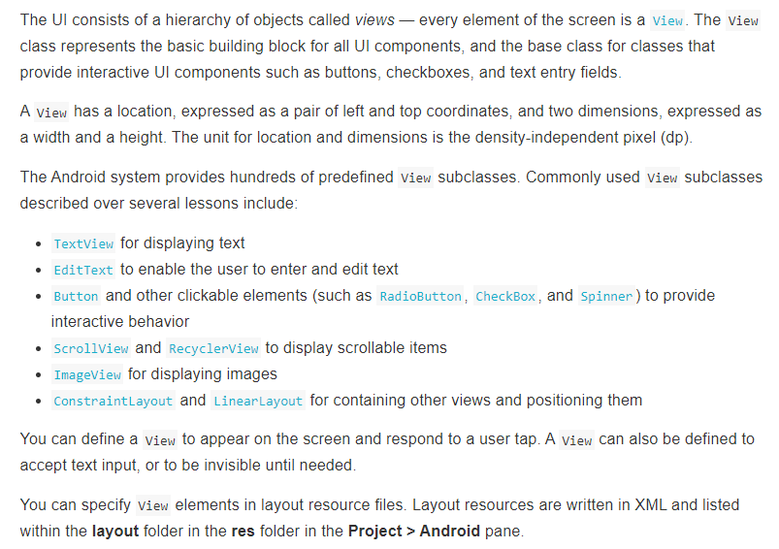
Views

Slide 8
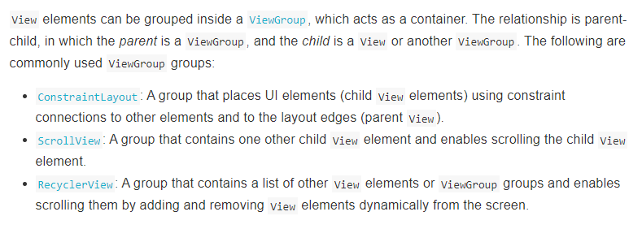
ViewGroup View

Slide 9
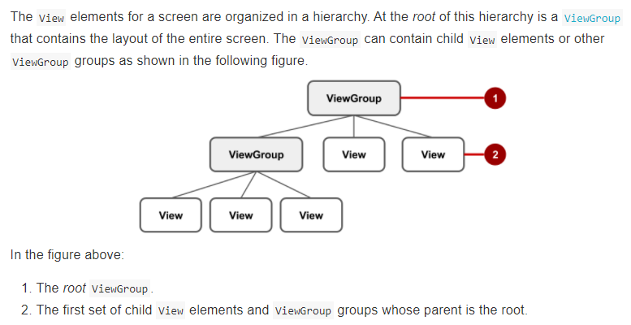
Layout ViewGroup View

Slide 10
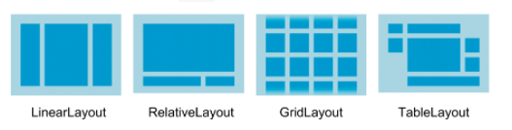
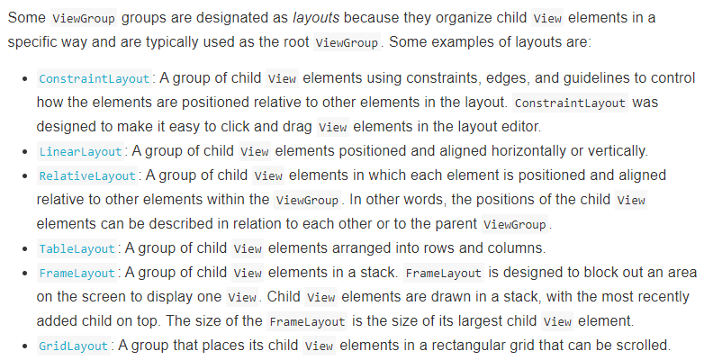

Slide 11
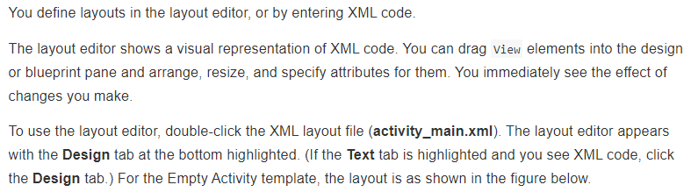
Layout Editor

Slide 12
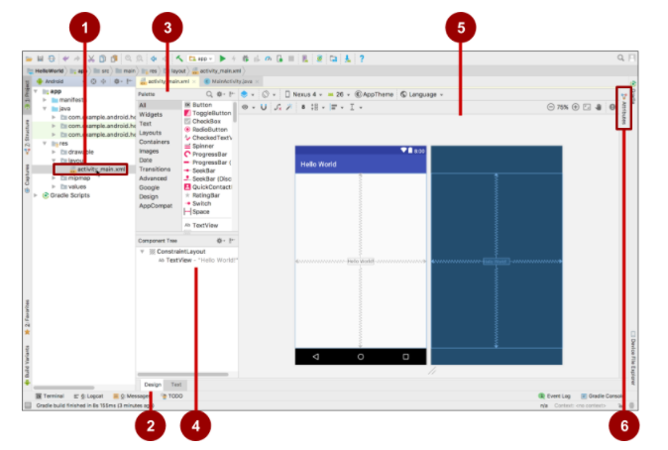

Slide 13
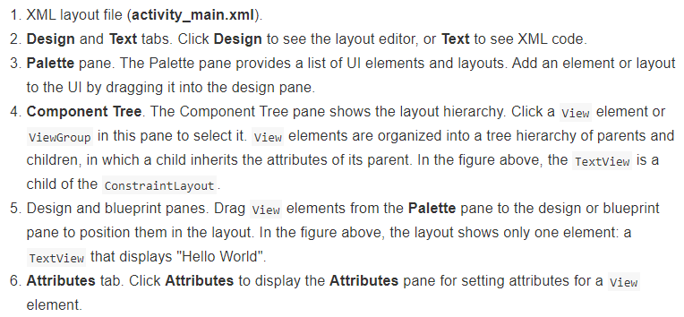

Slide 14
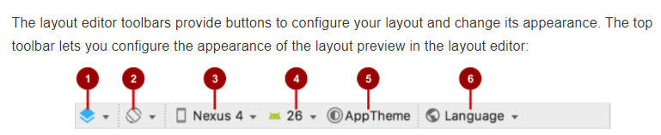
Layout Editor Toolbar

Slide 15
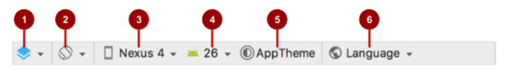
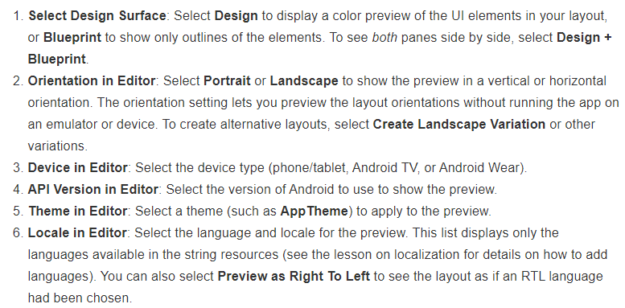

Slide 16

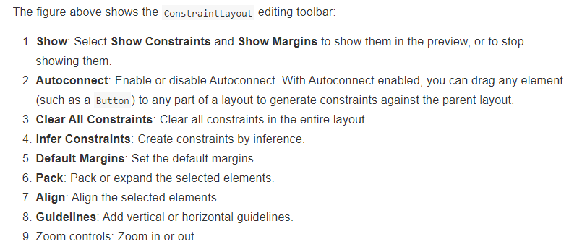

Slide 17
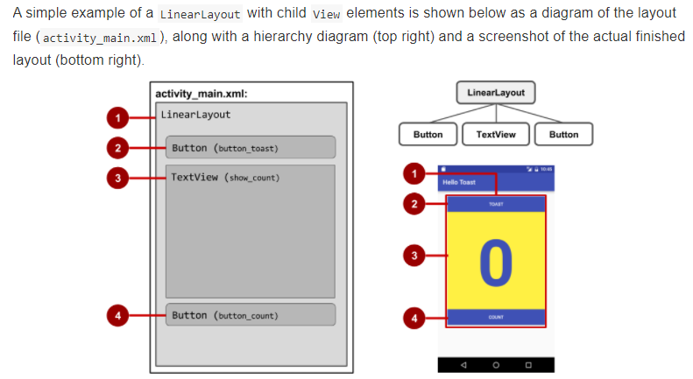
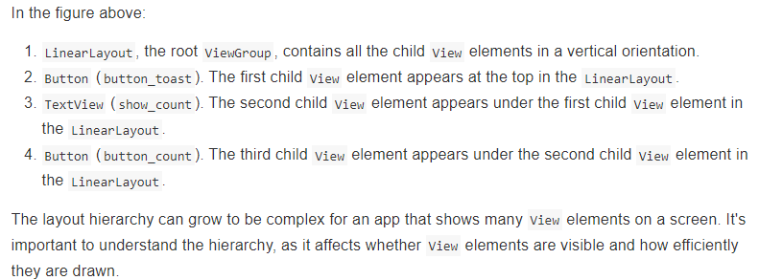
Linear Layout

Slide 18
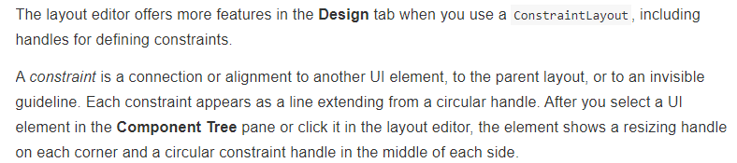
Using Constraint Layout

Slide 19
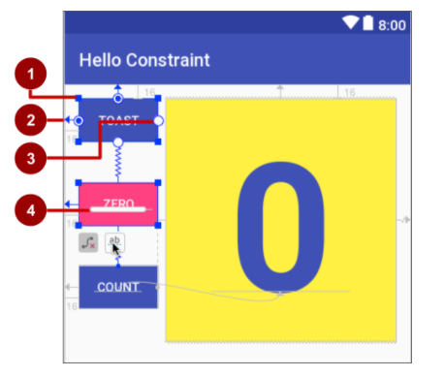
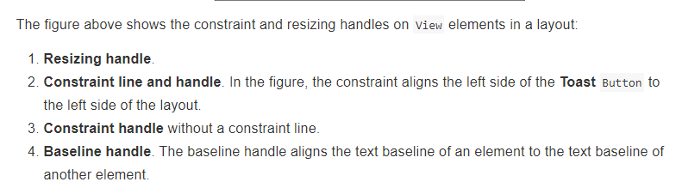
Constraint Layout

Slide 20
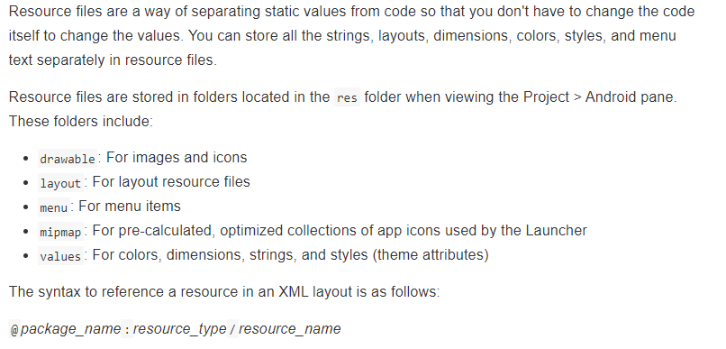
Resource File

Slide 21
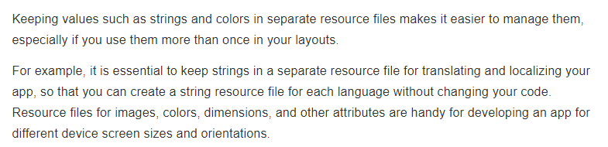
Value resource file

Slide 22
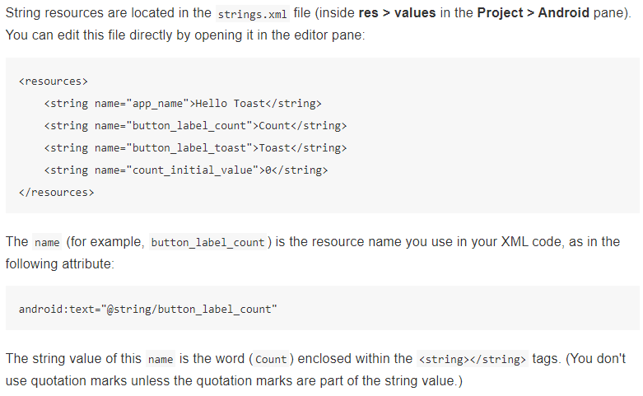
String

Slide 23
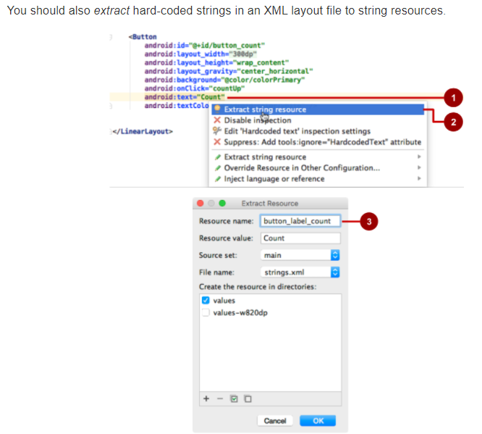
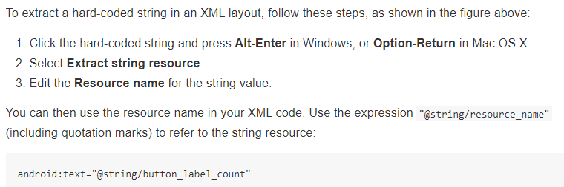
Extract String to Resources

Slide 24
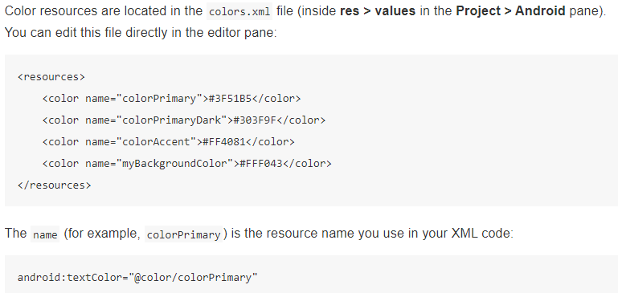
Color

Slide 25
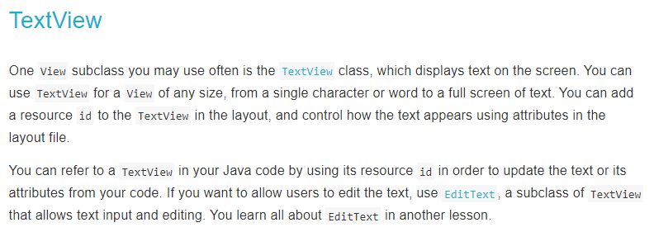

Slide 26
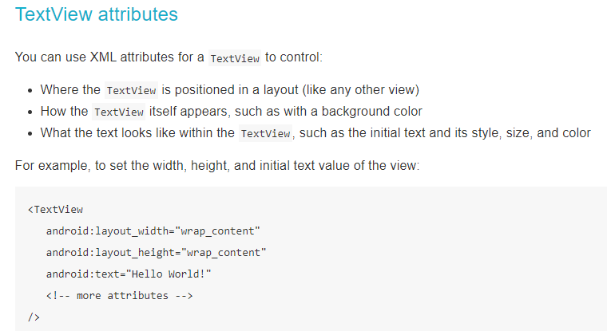

Slide 27
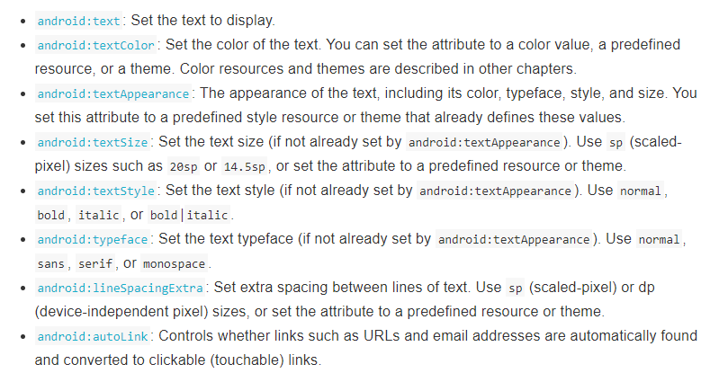
TextView Module

Slide 28
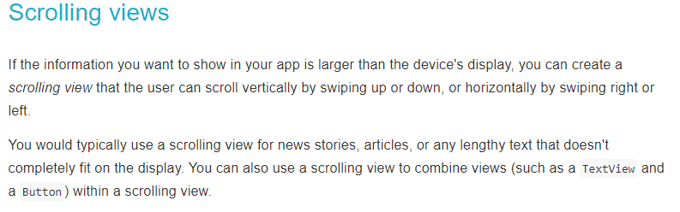

Slide 29
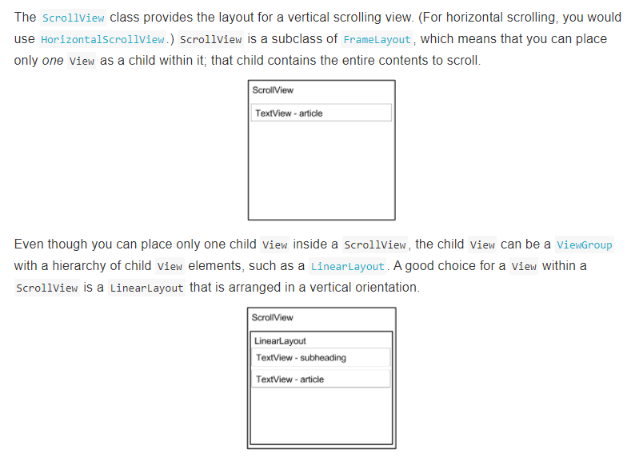

Slide 30
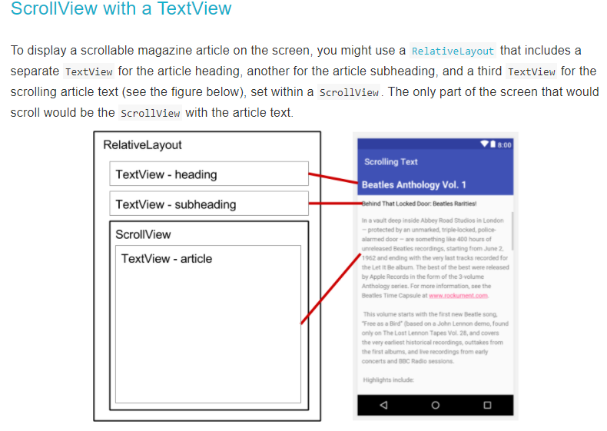

Slide 31
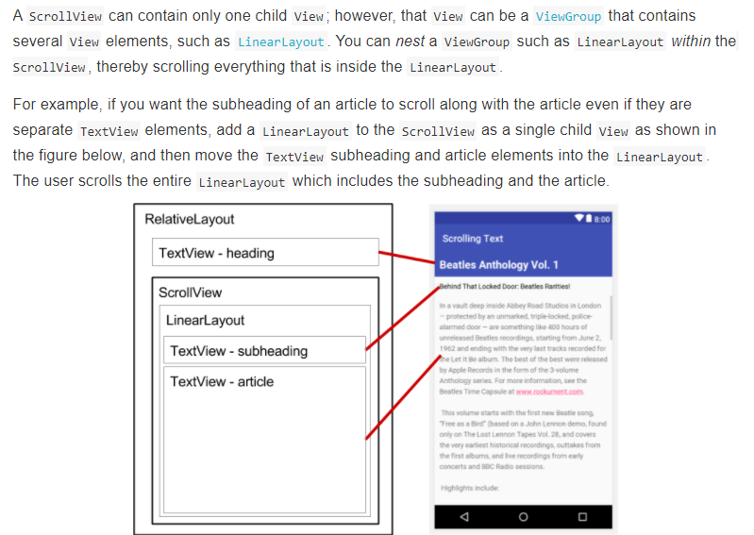

Slide 32
Build an App:
User Interface Setup

Slide 33
Bio App [User Interface Setup]
Focus on linear layout which allow us to linearly stack widget on the screen, either vertically or horizontally.
Scroll view which enables us to scroll up and down when we have more text than it can fit on screen. So that users can go up and down to read more about it.

Slide 34
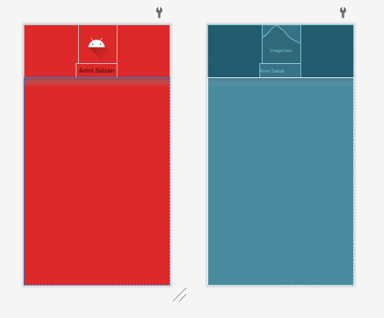
Bio App [User Inteface]
Linear Layout
Change orientation to vertical
Add image View
Change background color
Add Text View
Add padding
Create nameStyle

Slide 35
Build an App:
Adding ScrollView

Slide 36
Bio App [Adding ScrollView]
If there is too much text that does not fit on the screen, users can actually scroll up and down, so they can read the text.
ScrollView allows you to put at least just one view, widget and one parent widget.

Slide 37
Hello, my name is Amni Saizan, and I teach programming.
My mission is to help my students reach their goal of becoming a great programmer. I have experience in Moile App Development Android, Python, Java and Shell. I am also founder of Beauty y Ameni Sparkles.
<u><i>Build Apps with Amni Saizan</i></u>, where students have soft and technical skills. Showing students on how to make amazing application and software. My goal is to make you a great developer, no matteryour experience. I enjoy spending time with my growing family, baking cakes and cookies, selling Mary Kay products. I look forward to helping you become the best developer you can be. Thank you so much for being here. It means the world to me!

Slide 38
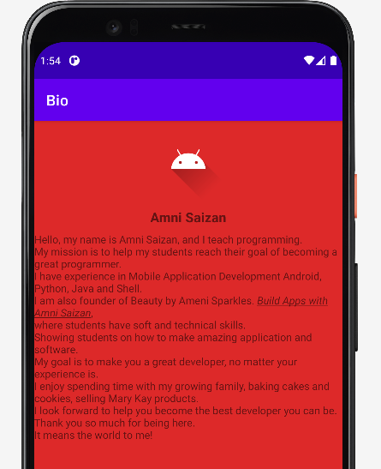

Slide 39
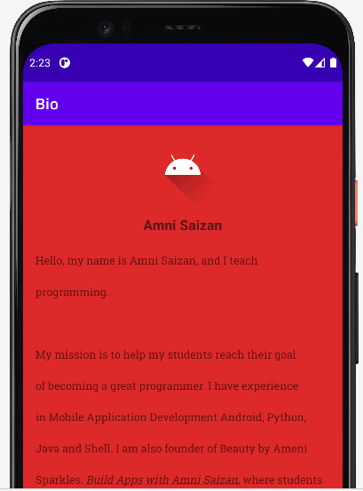

Slide 40
Build an App:
Adding Button and EditText

Slide 41
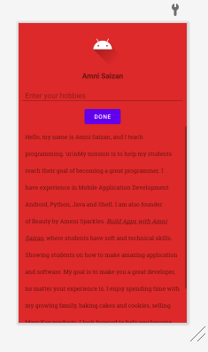
Adding Button and Edit Text
Let user enter their hobbies
Then user click button and the hobbies will be displayed.

