Slide 1
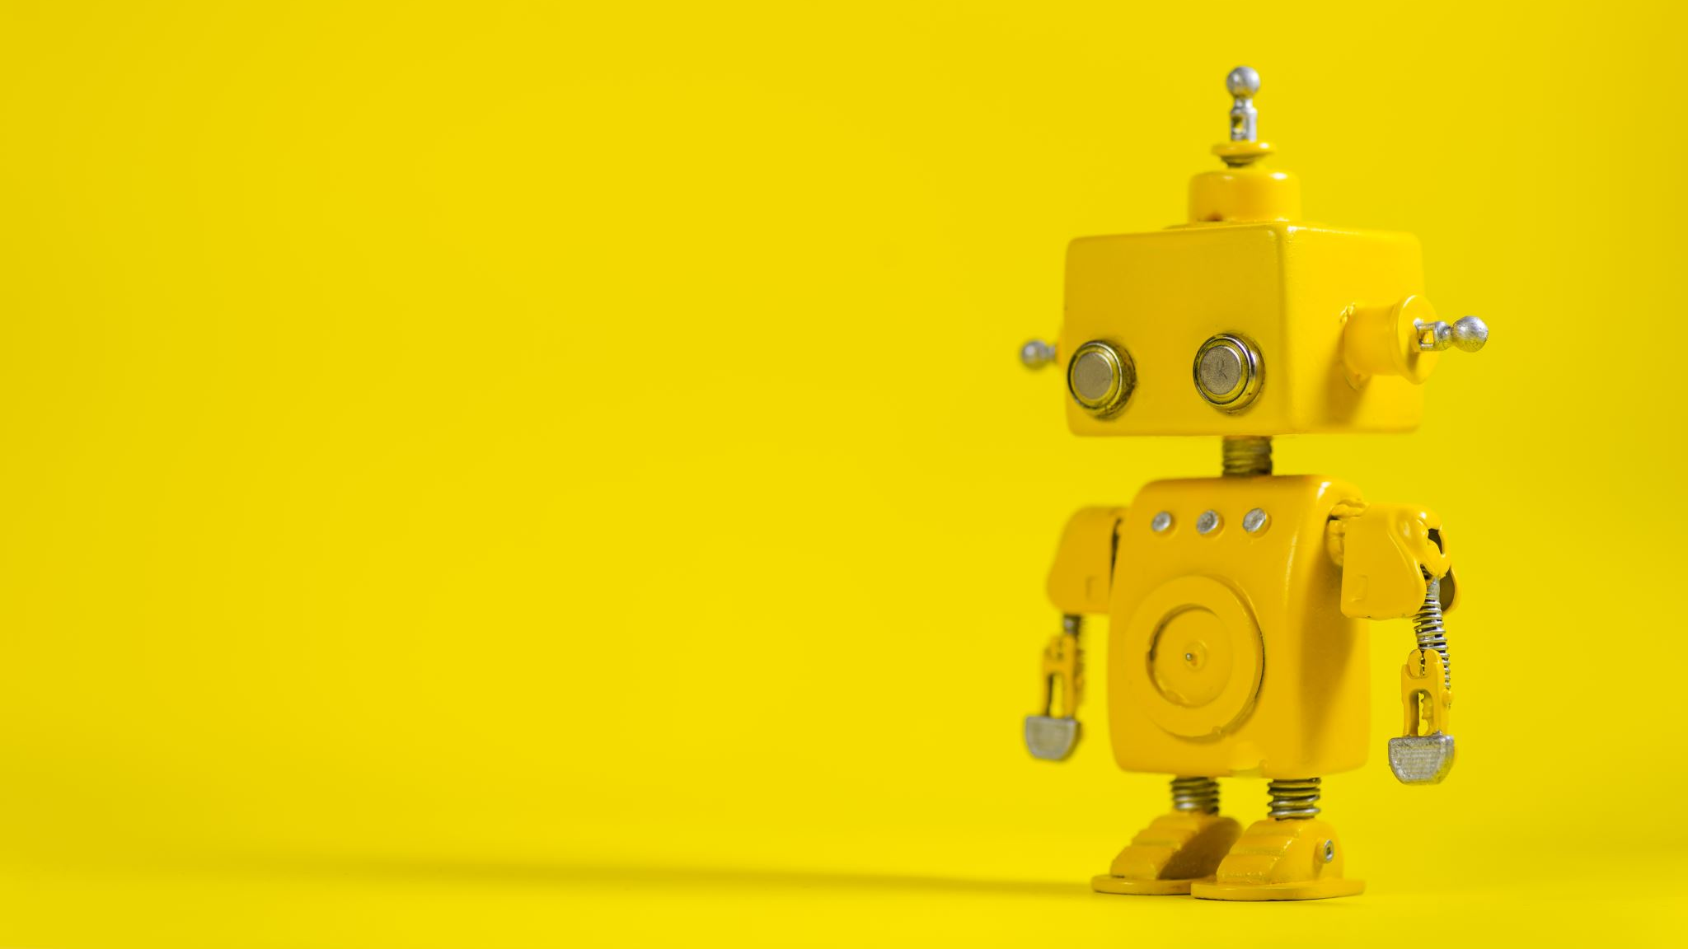
DATA BINDING IN ANDROID

Slide 2
Contents
Introduction of Data Binding
Example of Data Binding
Why data binding is important.

Slide 3

Introduction

Slide 4

DATA BINDING
Android offers support to write declarative layouts using data binding.
To minimizes the necessary code in app logic to connect to the user interface elements.
The usage of data binding requires changes in layout files.
In the layout file,
  Add all the widgets that we want to layout our user interface
  In activity, use findViewById each time we want to go and reference each of the widgets that we have added in user interface.

Slide 5
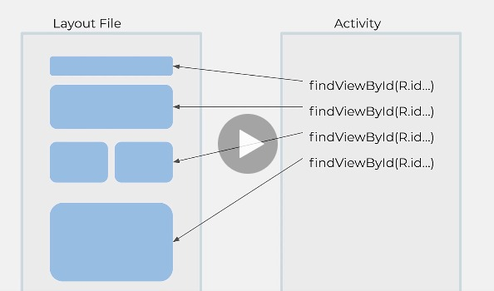
Without Data Binding
FindViewById is a expensive operation, which means each time we call findViewById it will traverse the entire
layout tree looking for specific id.
The more item and widgets we have in our screen, the longer it will take and more resources it will take to get that ID.

Slide 6
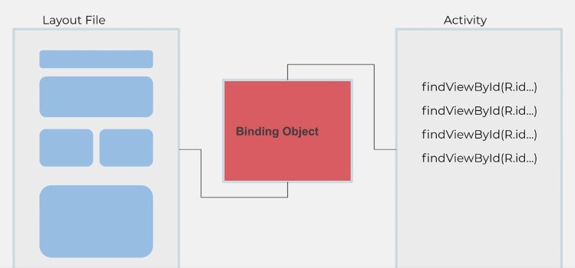
Concept of Data Binding
We have our layout file or widgets that layout correctly. We want to get their own ID.
But now we have an intermediary object called binding object.

Slide 7
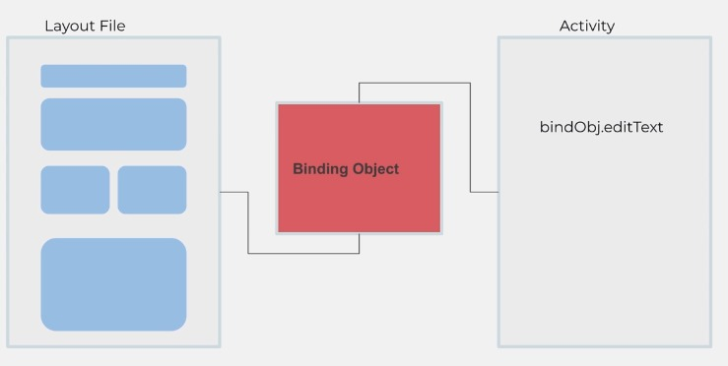
Concept of Data Binding
Binding object binds the layout view or layout widgets to a bigger object that encapsulated all of those IDs, all of those references to our widgets.
So now we just use binding object that bind object
We could call and say that to access points since added text from our interface or textView or whatever we added in our layout.
So this is much easier, faster than going to find and use findViewByID.

Slide 8

Developing Quiz Application
TrueCitizenApp

Slide 9
Model-View-Controller Architecture
Question
Model
Controller
View (Layouts)
MainActivity
Image View
Text View
Buttons

Slide 10
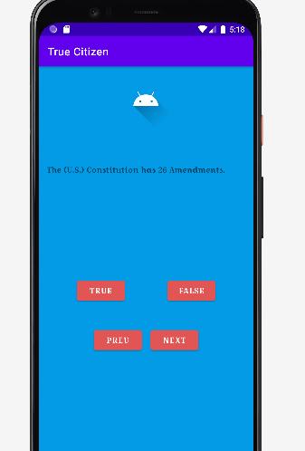
App: TrueCitizen
It is about a quiz application.
User needs to answer the question that inside the TextView.
Everytime users answer that question the app will matched whether the answer is correct or not.
User can click previous and next question as well.

Slide 11
PBL 2
Student need to create Quiz Android App that consists of 10 questions.
In this PBL they need to implement data binding.
They have to implement at least 4 buttons, 1 textView, 1 image View.
Everytime the answer is true. The image view will change to correct or incorrect sign and implement the snack bar.
Students needs to ensure their app is nice and easy to understand.

