Slide 1

ANDROID ACTIVITIES AND LIFE CYCLE

Slide 2
Contents
Android Activities and Life Cycle Callbacks
Showing Each Activity Life Cycle
Navigate to another activity
Receiving data from first activity
Using Bundle to retrieve data
Show data from second activity

Slide 3

Android Activities and Life Cycle Callbacks

Slide 4
Activity
Is basically every screen in which users can interact and perform action.
Most of the time, applications will contain multiple screen(activities) that users can use to navigate an app as they listen to music, play games, watch videos and so on.

Slide 5
Activity
The Activity class is a crucial component of an Android app, and the way activities are launched and put together is a fundamental part of the platform's application model.
When one app invokes another, the calling app invokes an activity in the other app, rather than the app as an atomic whole. In this way, the activity serves as the entry point for an app's interaction with the user. You implement an activity as a subclass of the Activity class.

Slide 6
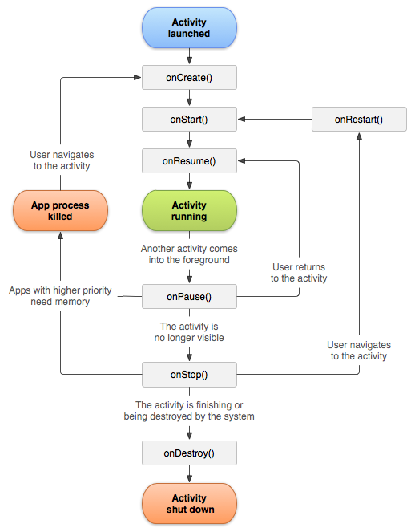

Slide 7
Managing ActivityLifeCycle()
Activity goes through several states. Use a series of callbacks to handle transitions between states.
CALLBACKS | DESCRIPTION
onCreate() | Must implement this callback, which fires when the system creates your activity. When onCreate() finishes, the next callback is always onStart().
Notes:
OnCreate is the first to be called when activity is first created. This is the place where we can create and setu views and accumulate the app’s state.

Slide 8
CALLBACKS | DESCRIPTION
onStart() | As onCreate() exits, the activity enters the Started state, and the activity becomes visible to the user. This callback contains what amounts to the activity’s final preparations for coming to the foreground and becoming interactive.
onResume() | The system invokes this callback just before the activity starts interacting with the user. At this point, the activity is at the top of the activity stack, and captures all user input. Most of an app’s core functionality is implemented in the onResume() method. The onPause() callback always follows onResume().
Notes:
onStart() is called immediately after onCreate(). It will make the app visible to the user.
onResume() is the stage when your users can finally interact with your application.

Slide 9
CALLBACKS | DESCRIPTION
onPause() | The system calls onPause() when the activity loses focus and enters a Paused state. An activity in the Paused state may continue to update the UI if the user is expecting the UI to update.
onStop() | when the activity is no longer visible to the user. This may happen because the activity is being destroyed, a new activity is starting, or an existing activity is entering a Resumed state and is covering the stopped activity. In all of these cases, the stopped activity is no longer visible at all.
Notes:
onPause() is called when another activity comes into foreground. Our other activity may still be visible in the background, however we won’t be able to interact with it. An example: bila ngh guna apps.. Then ade incoming call, kita open dialog box atau sthing else la
onStop()
When this executed you won’t be able to see your activity or interact with it. It’s important to note if an activity is completely obscured(keep from being seen) by another activity, it is stopped. It still retains all state and member information. But it is no longer visible to the user so its window is hidden.

Slide 10
CALLBACKS | DESCRIPTION
onRestart() | The system invokes this callback when an activity in the Stopped state is about to restart. onRestart() restores the state of the activity from the time that it was stopped.
onDestroy() | when the activity is no longer visible to the user. This may happen because the activity is being destroyed, a new activity is starting, or an existing activity is entering a Resumed state and is covering the stopped activity. In all these cases, the stopped activity is no longer visible at all.
Notes:
onDestroy()
This is called when we reached the final stage of an activity. There’s no going back.
At this point the system is free to garbage collect the activity data to free up space.

Slide 11
Showing Each Activity Life Cycle

Slide 12
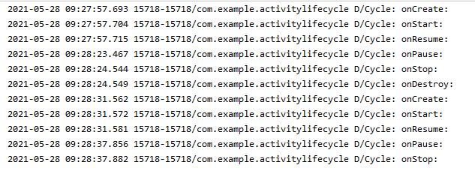
Write example of code of life cycle activity

Slide 13

Developing Quiz Application
TrueCitizenApp

Slide 14
Model-View-Controller Architecture
Question
Model
Controller
View (Layouts)
MainActivity
Image View
Text View
Buttons

Slide 15
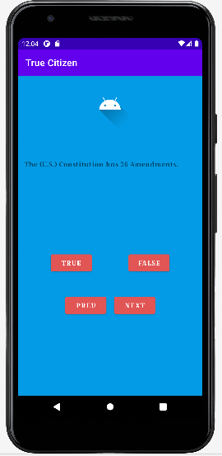

Slide 16
Navigate to Another Activity

Slide 17
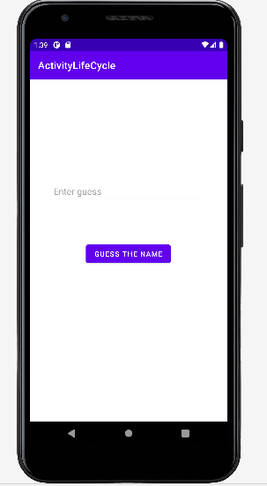
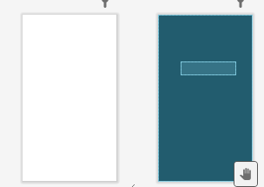

Slide 18
Receiving data from first activity

Slide 19
Using Bundle to retrieve data

