Slide 1

6. Logcat
Side Chapters ☺

Slide 2
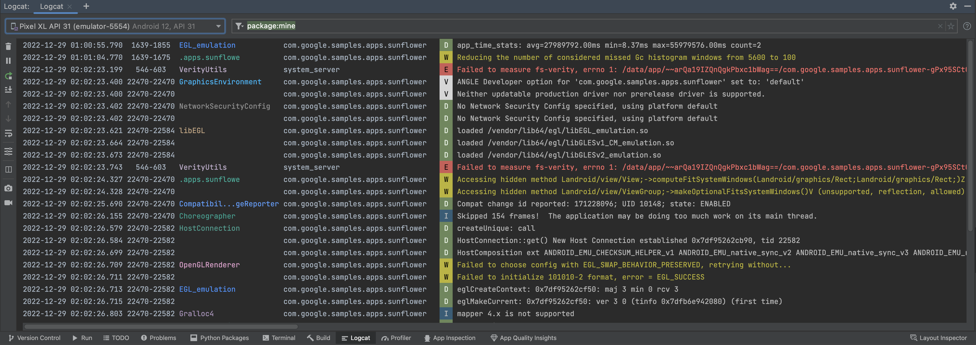
Familiar?

Slide 3
Introduction
Android applications utilize the android.util.Log class for logging messages to the system's log buffer, which can then be viewed using the Logcat tool in Android Studio or via the adb logcat command-line tool.
The Log class provides several methods for logging messages at different priority levels:

Slide 4
Log.v(String tag, String msg): Verbose level, for detailed information that may be useful during development.
Log.d(String tag, String msg): Debug level, for debugging information.
Log.i(String tag, String msg): Info level, for informational messages about the application's progress.
Log.w(String tag, String msg): Warn level, for potential issues or non-critical errors.
Log.e(String tag, String msg): Error level, for actual errors that have occurred.
Log.wtf(String tag, String msg): Assert level, for situations that should never happen, indicating a serious problem.

